Slide 1
COMP229 Web Application Development
Week 1 – Part 1
Tools Installation and Setup

Slide 2
Lesson Objectives
Download and Install Visual Studio Code
Version Control – What is it and Why you need it.
Brief History of Version Control Systems
Download and Install git
Register a GitHub account
Setup your first GitHub repo
Download and Install nodeJS
Download and Install MongoDB
How to deal with errors after installation
Download and Install 3rd party npm modules

Slide 3
Installing Visual Studio Code

Slide 4
Visual Studio Code
To get started, you need an editor or an IDE to work with JavaScript
For a developer, choosing a code editor is a personal choice.
And, there are many choices, like Sublime Text, Atom, Webstorm, or even a simple text editor like Notepad in Windows.
Some Developers also choose a full-fledged IDE like Microsoft Visual Studio (current version is Visual Studio 2019).
Our recommendation is Visual Studio Code. First, it is free, lightweight, and open source.
The features set is driven by Microsoft which is updated monthly with features and enhancements.

Slide 5
Visual Studio Code (continued)
Visual Studio Code is great for working with JavaScript and TypeScript (which we’ll be using in the second half of the course).
It quickly shows warnings and errors as you type code.
There are easy-to-peek-into definitions for the functions. It also has a good ecosystem and extensions created by developers from around the world.

Slide 6
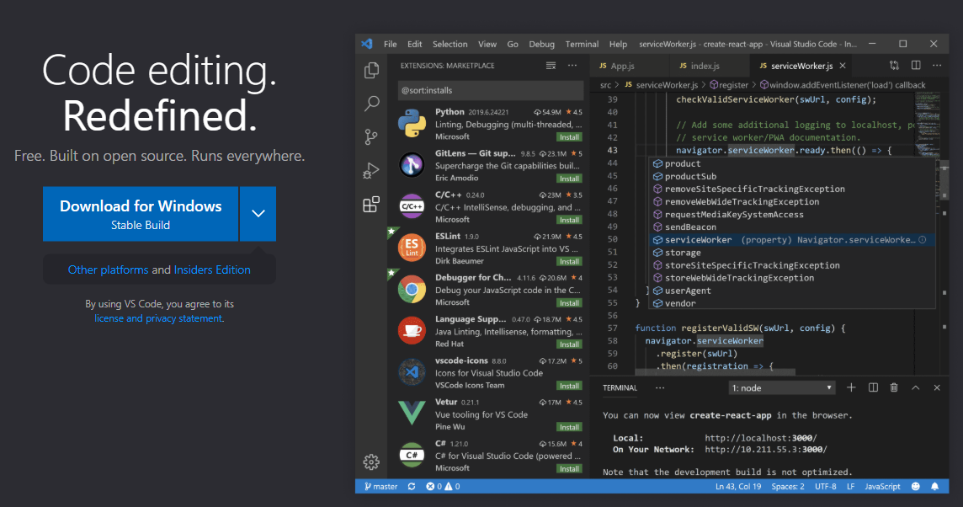
Visual Studio Code (continued)
To install Visual Studio Code, download it from https://code.visualstudio.com

Slide 7
Version Control

Slide 8
What is Version Control?
As the name implies, Version Control is about the management of multiple versions of a project.
To manage a version, each change (addition, edition, or removal) to the files in a project must be tracked.
Version Control records each change made to a file (or a group of files) and offers a way to undo or roll back each change.
For an effective Version Control, you have to use tools called Version Control Systems.

Slide 9
What is Version Control? (continued)
Version Control Systems help you navigate between changes and quickly let you go back to a previous version when something isn’t right.
One of the most important advantages of using Version Control is teamwork.
When more than one person is contributing to a project, tracking changes becomes a nightmare, and it greatly increases the probability of overwriting another person’s changes.
With Version Control, multiple people can work on their copy of the project (called branches) and only merge those changes to the main project when they (or the other team members) are satisfied with the work.

Slide 10
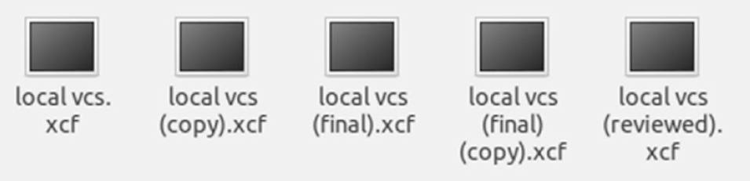
Why do you need to use Version Control?
Have you ever worked on a text project or on code that requires you to recall the specific changes made to each file? If yes, how did you manage and control each version?
Maybe you tried to duplicate and rename the files with suffixes like “review,” “fixed,” or “final”?
The figure above demonstrates what many people do to deal with file changes.
As you can see, this has the potential to go out of hand very quickly.
It is very easy to forget which file is which and what has changed between them.

Slide 11
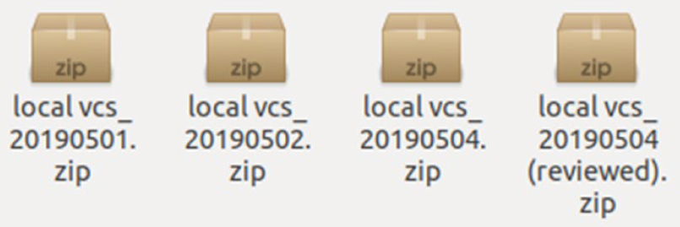
Why do you need to use Version Control? (continued)
To track versions, one idea is to compress the files and append timestamps to the names so that the versions are arranged by date of creation.
The solution shown in figure above appears to be the perfect system until you realize that even though the versions are tracked, there is no way to know what the contents and descriptions are of each version.

Slide 12
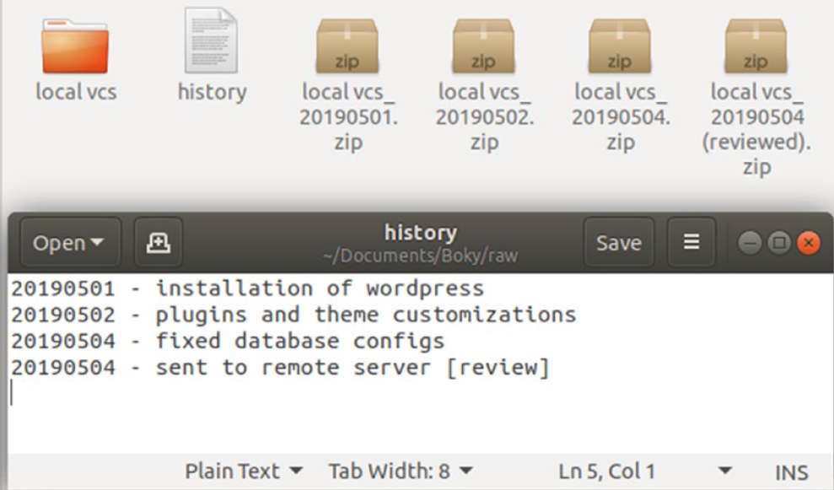
Why do you need to use Version Control? (continued)
To remediate that situation, some developers use a solution like the one showed in the figure below, which is to put the change summary of each version in a separate file.
That should do it, right? Not quite, you would still need a way to compare each version and every file change.
There is no way to do this in that system; you just need to memorize everything you did. And if the project gets big, the folder just gets bigger with each version.

Slide 13
Why do you need to use Version Control? (continued)
What happens when another developer joins your team?
Would you email each other the files or versions you edited? Or work on the same google drive folder? In the last case, how would you know who is working on which file and what changed?
And lastly, have you ever felt the need to undo a change you made years ago without breaking everything in the process? An unlimited and all-powerful ctrl-z?
What about if your files became corrupted or you had a code-base that was recently working but some unknown breaking changes broke your build?
All those problems are solved by using a Version Control System or VCS.
A VCS tracks each change you made to every file of your project and provides a simple way to compare and roll back those changes.

Slide 14
Why do you need to use Version Control? (continued)
Each version of the project is also accompanied by the description of the changes made along with a list of the new or edited files.
When more people join the project, a VCS can show exactly who edited a particular file on a specific time.
All of that makes you gain precious time for your project because you can focus on writing code instead of spending time tracking each change.
So to sum up, the main reasons to use a Version Control System are:
Backup (with the ability to roll back any changes)
Collaboration (teamwork)
Version Control (tracking changes)

Slide 15
History of Version Control
Version control software has seen an evolution of three generations:
First Generation:
Version control software utilized a locking mechanism on files to allow a change to occur on the file.
A file could only be worked on by one individual at a given point in time.
During this period, SCCS (Source Code Control System) and RCS (Revision Control System) were the common version control software in use.

Slide 16
History of Version Control (continued)
Second generation:
Used a merge-before-commit mechanism to support concurrent editing of a file by multiple users.
To incorporate changes into a file, you would be are required to merge changes made by others to the same file.
Once done, you would then proceed to commit your change to the file of interest.
This generation of software introduced the use of centralized repositories.
Subversion is an example of a second-generation version control system (still in use today).

Slide 17
History of Version Control (continued)
Third generation:
Decentralized in nature.
Each developer obtains a copy of the repository.
Changes to the remote repository are introduced by way of a merge.
To allow multiple individuals to work on the same file, a commit-before-merge mechanism is used.
Here, you make changes to the local repository, to incorporate changes made to the remote repository, you commit the local changes, after which you are able to merge changes made by other individuals.
Git is a third-generation version control tool.

Slide 18
Common Terminologies
Repository (or repo)
A unit of storage and change tracking that represents a directory (or container) whose contents are tracked by Git.
Branch
A version of a repository that represents the current state of the set of files that constitute a repository.
In a repository, there exists a default or main branch (AKA: the “master branch”) that represents the single source of truth.

Slide 19
Common Terminologies (continued)
Commit
This is an entry into Git's history that represents a change made to a set of files at a given point in time (think of this as a ”snapshot” of your project)
A commit references the files that have been added to the index and updates the HEAD to point to the new state of the branch.
HEAD
A reference to the most recent commit on a branch. The most recent commit is commonly referred to as the tip of the branch.

Slide 20
Common Terminologies (continued)
Merge
The process of incorporating changes from one branch to another.

Slide 21
Git Basic Workflow
Create a project, typically in a folder on your computer.
Tell your version control system of choice to track the changes of your project/folder.
Each time your project is in a working state, or you’re going to walk away from it, tell your version control system of choice to save it as the next version.
If you ever need to go back to a previous version, you can ask your version control system to revert to whichever previous version you need.

Slide 22
The three stages of making a commit
Git has three main states that your files can reside in: modified, staged, and committed:
Modified means that you have changed the file but have not committed it to your database yet.
Staged means that you have marked a modified file in its current version to go into your next commit snapshot.
Committed means that the data is safely stored in your local database.

Slide 23
The three stages of making a commit (continued)
The following diagram describes the three stages of creating a commit and the commands used to move between them:

Slide 24
The three stages of making a commit (continued)
The working tree is a single checkout of one version of the project. These files are pulled out of the compressed database in the Git directory and placed on disk for you to use or modify.
The staging area is a file, generally contained in your Git directory, that stores information about what will go into your next commit. Its technical name in Git parlance is the “index”, but the phrase “staging area” works just as well.
The Git directory is where Git stores the metadata and object database for your project. This is the most important part of Git, and it is what is copied when you clone a repository from another computer.

Slide 25
The Command Line
There are a lot of different ways to use Git.
There are the original command-line tools, and there are many graphical user interfaces of varying capabilities.
The command line is the only place you can run all Git commands — most of the GUIs implement only a partial subset of Git functionality for simplicity.
If you know how to run the command-line version, you can probably also figure out how to run the GUI version, while the opposite is not necessarily true.
We’ll go over various GUI options later in this lesson

Slide 26
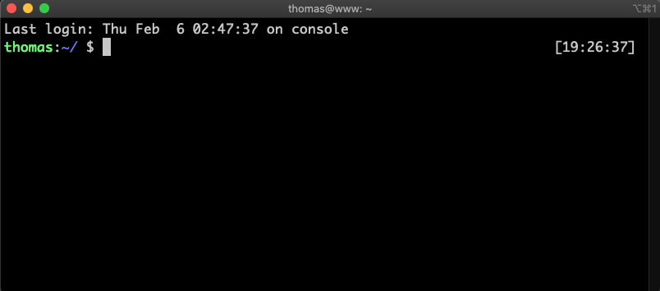
The Command Line (continued)
While your choice of graphical client is a matter of personal taste, all users will have the command-line tools installed and available.
iTerm MacOS
Command Prompt Windows 10

Slide 27
Installing git

Slide 28
Installing Git
Before you start using Git, you have to make it available on your computer.
Even if it’s already installed, it’s probably a good idea to update to the latest version.
You can either install it as a package or via another installer, or download the source code and compile it yourself.

Slide 29
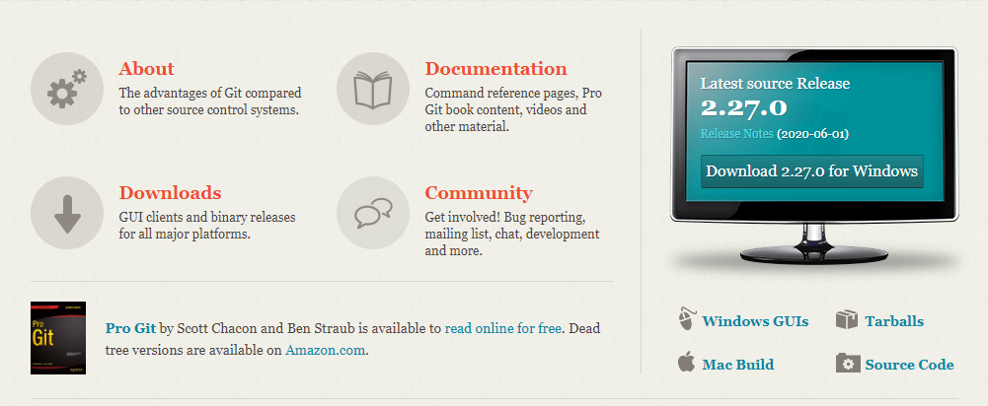
Installing Git (continued)
Installing on Windows
The most official build is available for download on the Git website. Just go to https://git-scm.com/download/win and the download will start automatically.

Slide 30
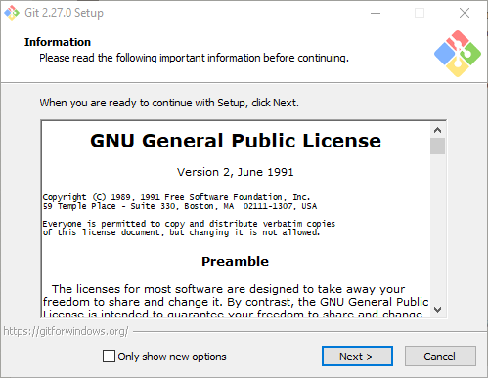
Installing Git (continued)

Slide 31
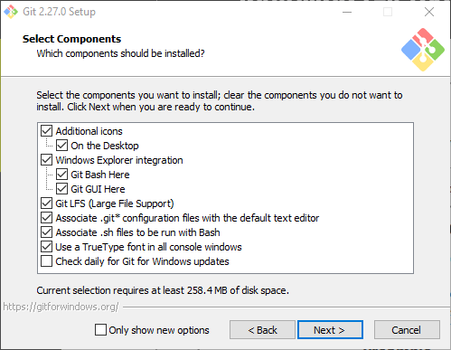
Installing Git (continued)

Slide 32
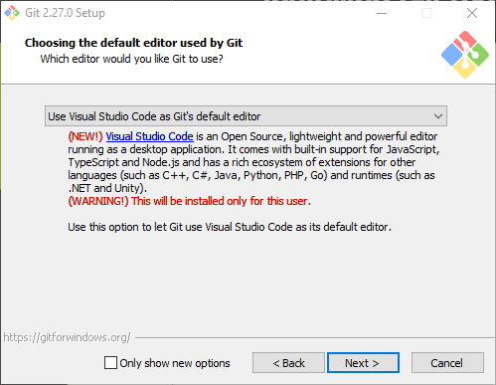
Installing Git (continued)
We recommend using Visual Studio Code as Git’s default editor

Slide 33
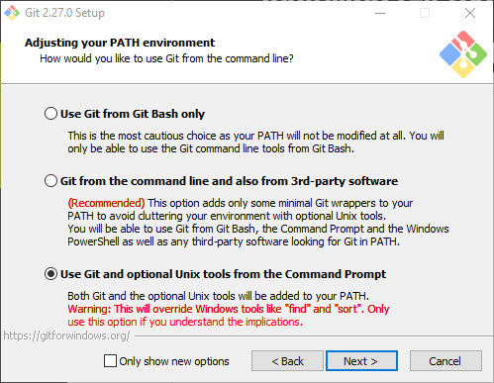
Installing Git (continued)

Slide 34
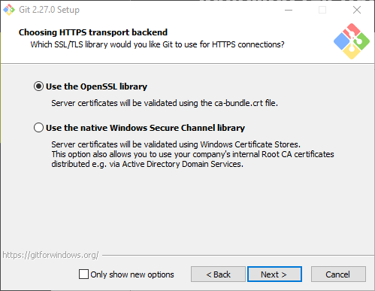
Installing Git (continued)

Slide 35
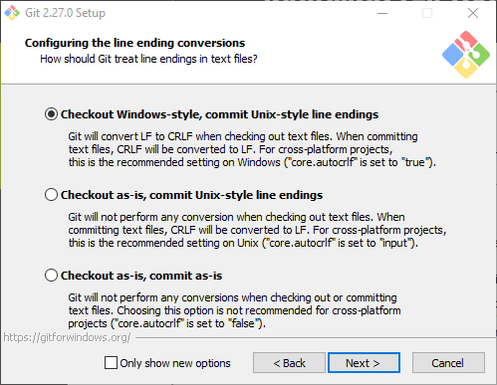
Installing Git (continued)

Slide 36
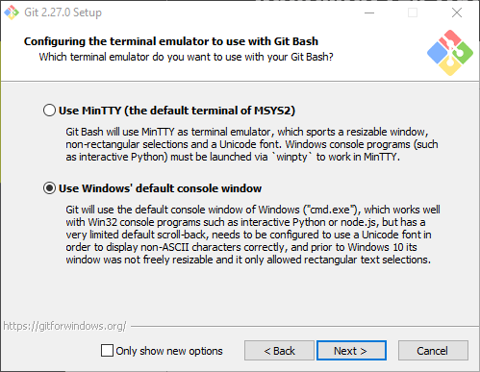
Installing Git (continued)

Slide 37
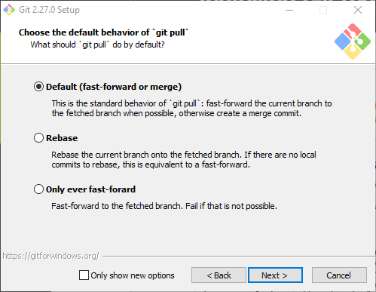
Installing Git (continued)

Slide 38
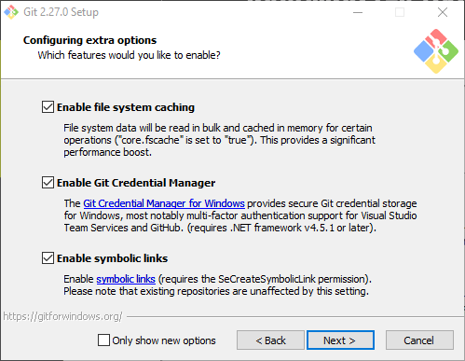
Installing Git (continued)

Slide 39
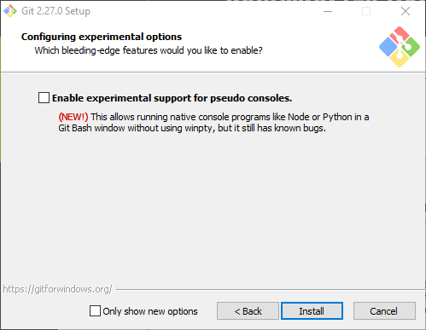
Installing Git (continued)

Slide 40
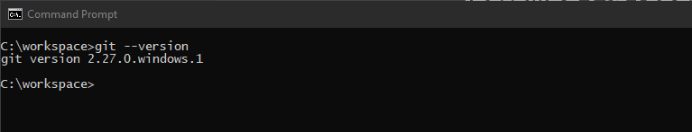
Installing Git (continued)
Verify your installation by opening a command prompt.
Enter the command: git --version and press enter

Slide 41
First Time Git Setup
Your Identity
The first thing you should do when you install Git is to set your user name and email address.
This is important because every Git commit uses this information, and it’s immutably baked into the commits you start creating.
Open a command prompt and enter your information:
The email address you enter should be the same one that you will use to register for a new GitHub account.

Slide 42
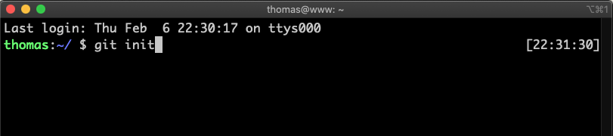
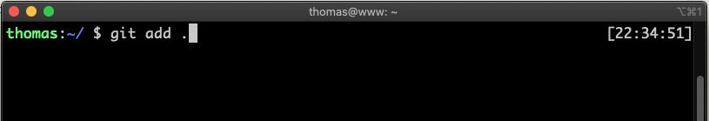
Git Basics
Step 1. Navigate to your project folder on your computer
Step 2. Initialize your local git repo by typing git init
Step 3. add all your files to the staging area by typing git add .

Slide 43
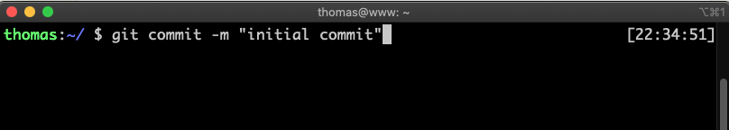
Git Basics (continued)
Step 4. Create your first commit by typing git commit –m “initial commit”

Slide 44
Navigating GitHub
Version control with Git takes on a distributed nature.
The code resides on each local computer where the code base is being worked on, as well as on a central remote point where every individual who wishes to work on the code base can obtain it.
GitHub is one such central remote point.
GitHub hosts repositories and enables users to obtain, alter, and integrate changes to a code base through Git:

Slide 45
Setting Up a GitHub Account

Slide 46
Setting Up a GitHub Account
Navigate to https://github.com/. Enter your user details, as shown in the following screenshot, and press the Sign up for GitHub button:

Slide 47

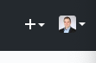
Creating your first repo on GitHub
Step 1: On GitHub, you can start creating your repo by either clicking on the New button:
Or the + symbol next to your avatar at the top right corner of the page

Slide 48
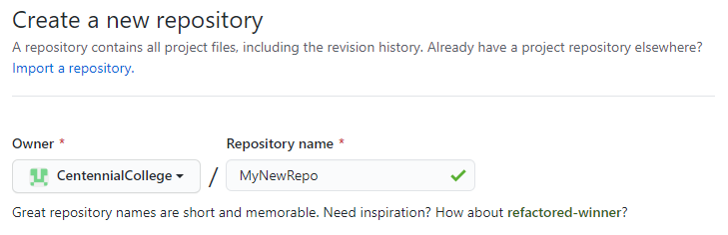
Creating your first repo on GitHub (continued)
Step 2: Select a repository name next to your account or team name. The name of the repo must be unique for your account:

Slide 49
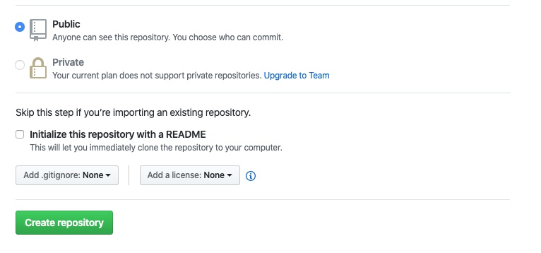
Creating your first repo on GitHub (continued)
Step 3: You can leave the repo as public for now. Also, you can leave initialize this repository with a README unchecked.
Step 4: Click the Create repository button.

Slide 50
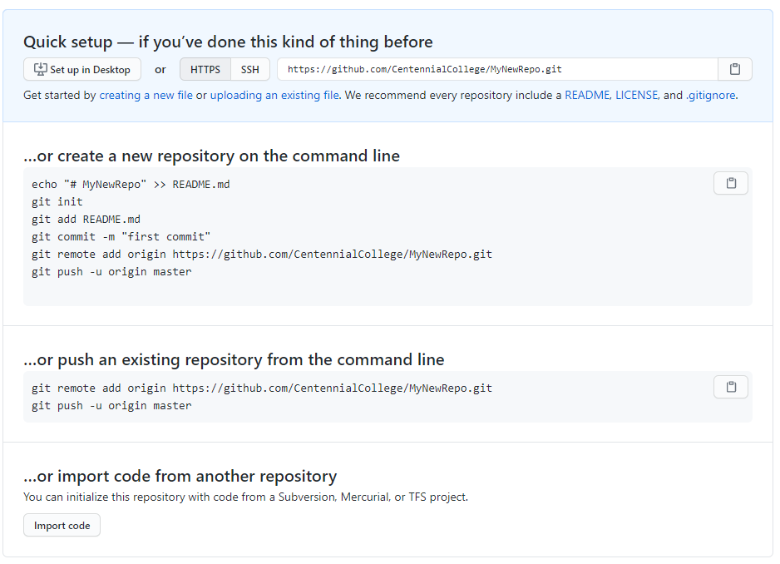
Connecting your local repo to your GitHub repo
GitHub will create the new repo and display a page with the following information:

Slide 51
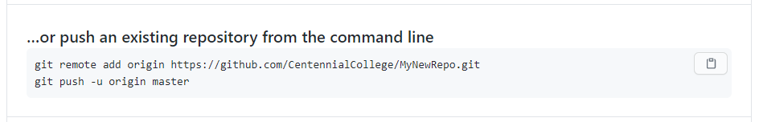
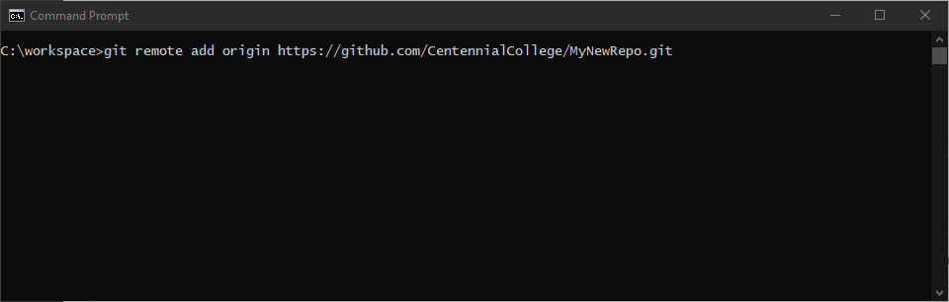
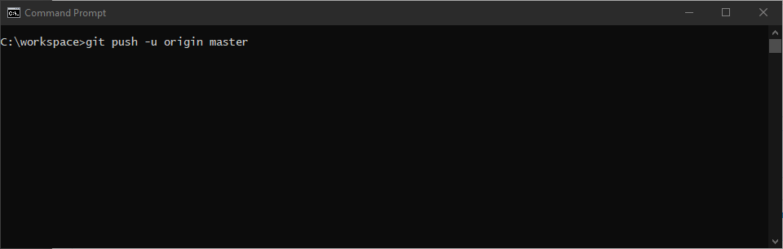
Connecting your local repo to your GitHub repo (continued)
To link your GitHub repo with the local repo you created earlier you need to copy the following two lines of code:
Then paste into your Command Line window

Slide 52
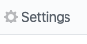
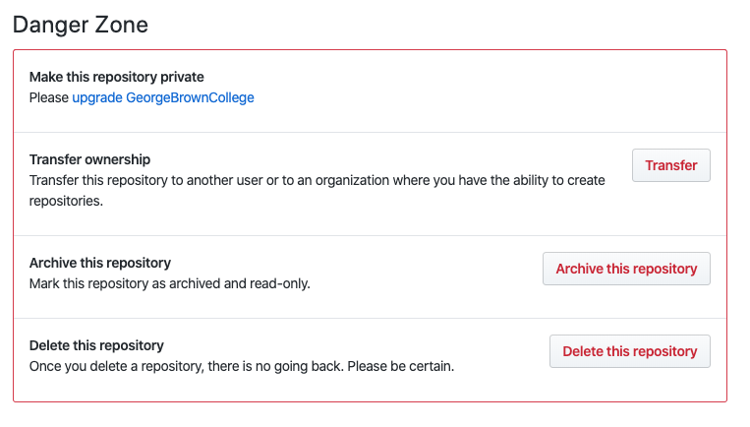
Deleting a repo
Sometimes you need to remove a repo. This may be due to broken connections between your local repo (on your computer) and your GitHub repo (or other problems).
Step 1: Click on the Settings link on your repo’s page
Step 2: scroll down to the Danger Zone and select the Delete this repository button

Slide 53
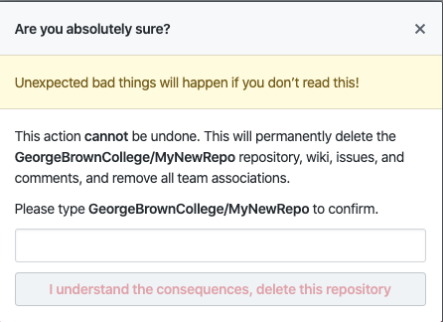
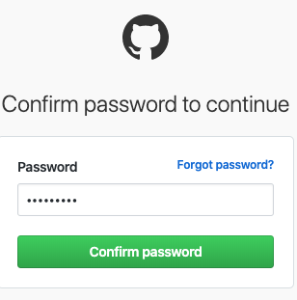
Deleting a repo (continued)
Step 3: Confirm that you wish to Delete the repo. You cannot undo this action.
Step 4: Click the I understand the consequences, delete this repository button. You will then be asked to confirm by entering your account password.

Slide 54
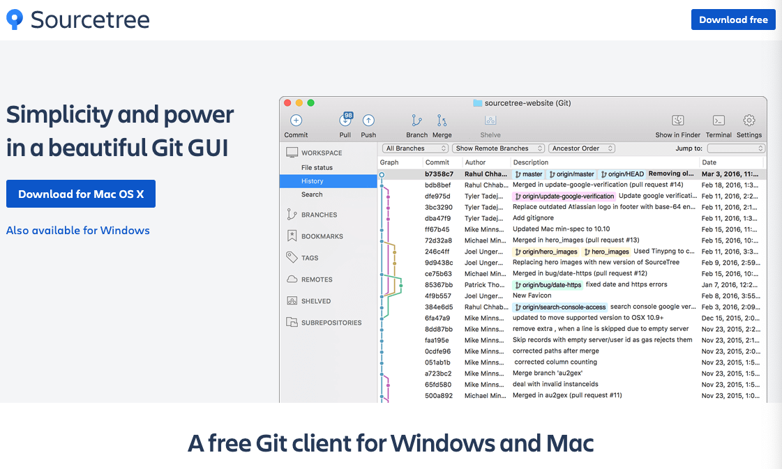
Common GUI Clients
Sourcetree: https://www.sourcetreeapp.com/

Slide 55
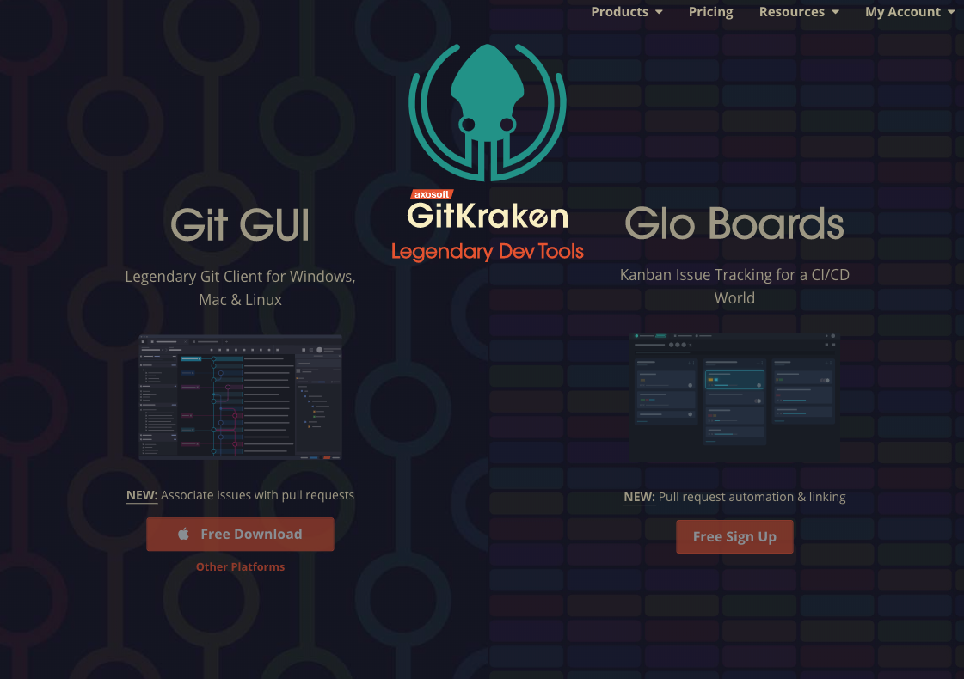
Common GUI Clients (continued)
GitKraken: https://www.gitkraken.com/

Slide 56
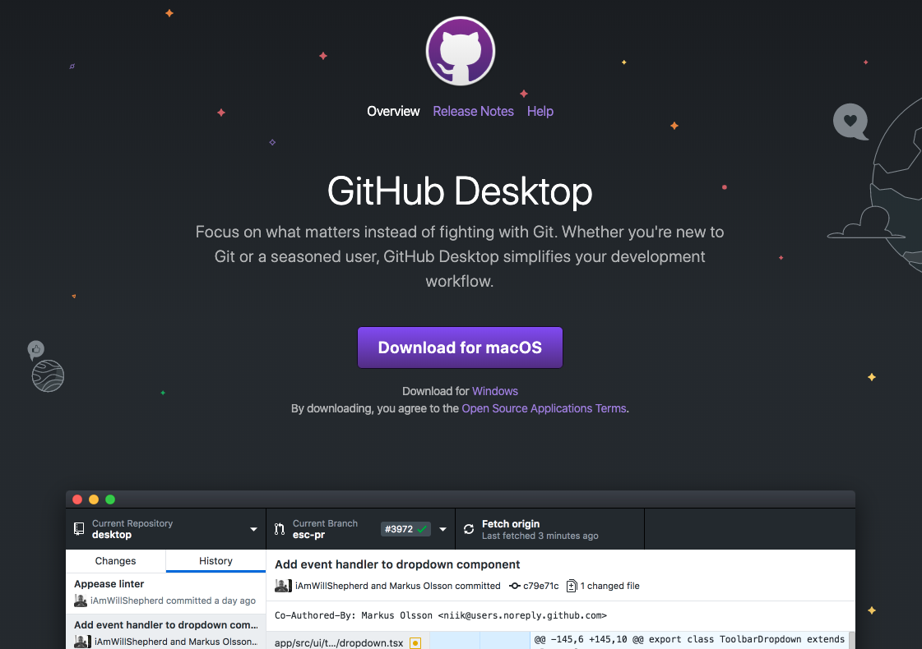
Common GUI Clients (continued)
GitHub Desktop: https://desktop.github.com/

Slide 57
Installing NodeJS

Slide 58
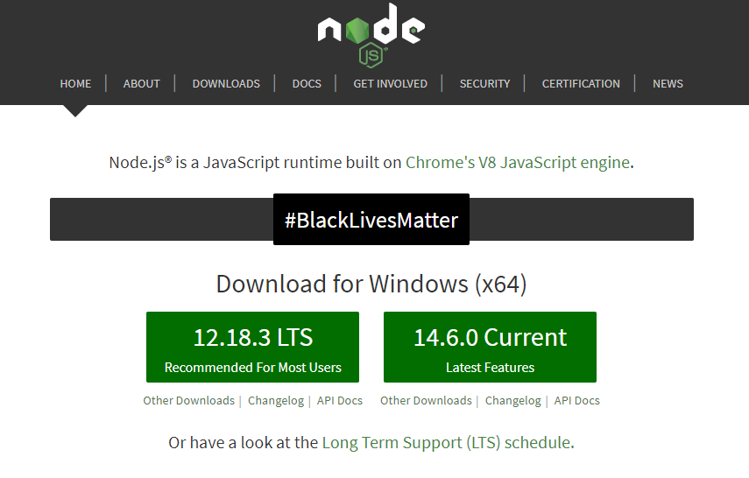
Installing NodeJS
Another core tool we’ll be using in this course is NodeJS.
Install NodeJS by navigating to https://nodejs.org and selecting the current version

Slide 59
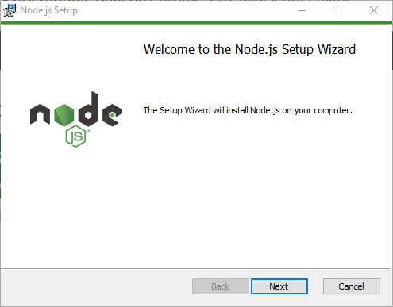
Installing NodeJS (continued)

Slide 60
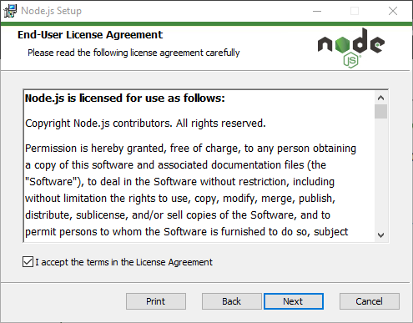
Installing NodeJS (continued)

Slide 61
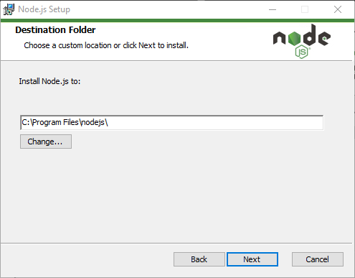
Installing NodeJS (continued)

Slide 62
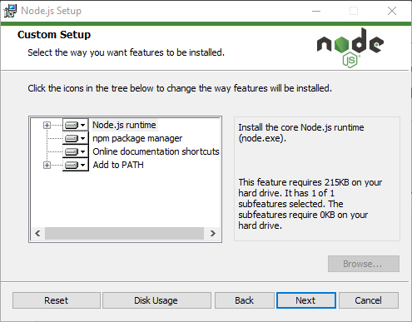
Installing NodeJS (continued)

Slide 63
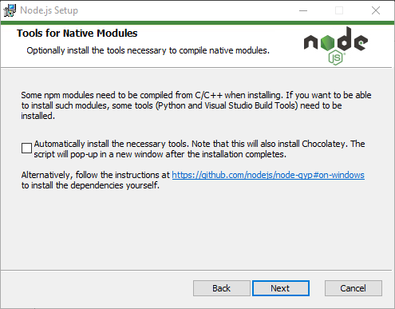
Installing NodeJS (continued)

Slide 64
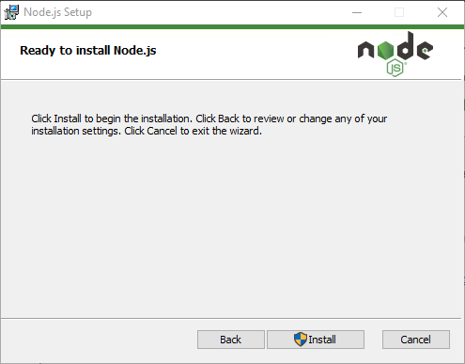
Installing NodeJS (continued)

Slide 65
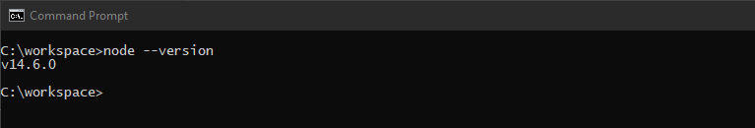
Installing NodeJS (continued)
Verify your installation by opening a command prompt.
Enter the command: node --version and press enter.

Slide 66
Install MongoDB

Slide 67
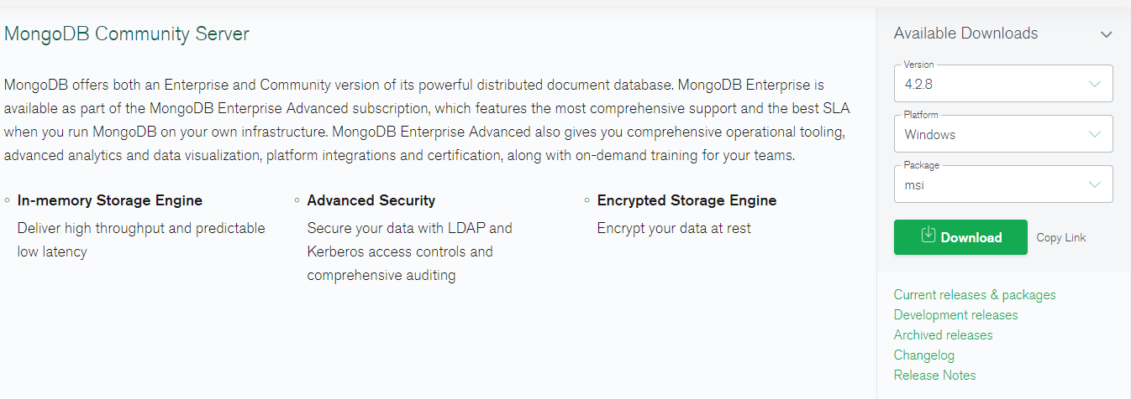
Install MongoDB
MongoDB is another tool we’ll be using in this course.
To Download MongoDB navigate to: https://www.mongodb.com/try/download/community

Slide 68
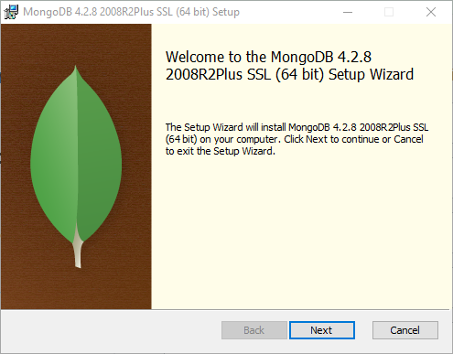
Install MongoDB (continued)

Slide 69
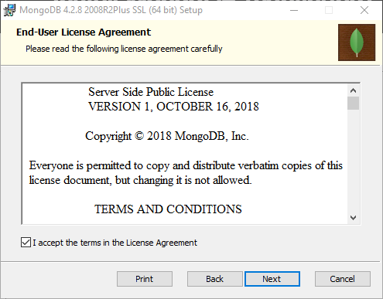
Install MongoDB (continued)

Slide 70
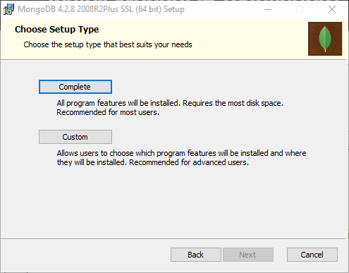
Install MongoDB (continued)
Select Custom and then Next.

Slide 71
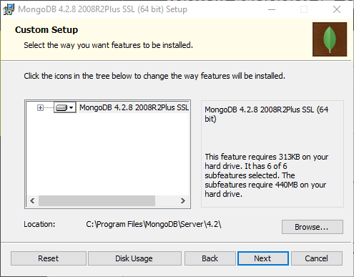
Install MongoDB (continued)

Slide 72
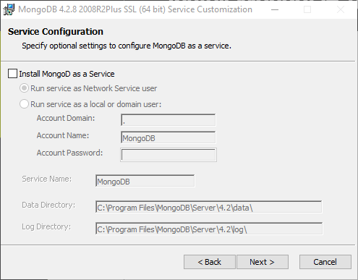
Install MongoDB (continued)
Do not install MongoDB as a service.

Slide 73
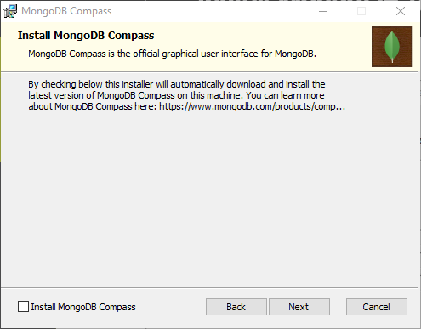
Install MongoDB (continued)
Do not install Compass

Slide 74
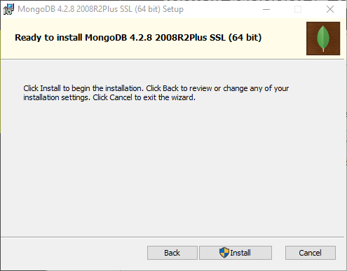
Install MongoDB (continued)

Slide 75

Install MongoDB (continued)

Slide 76


Install MongoDB (continued)
Open a command prompt
Navigate to the root folder on your C: drive by typing the following command: cd c:\
Create a new folder named data by typing the following command: mkdir data

Slide 77



Install MongoDB (continued)
Navigate to the data folder by typing the following command: cd data
Create a new folder named db by typing the following command: mkdir db

Slide 78

Install MongoDB (continued)
Now test your installation by issuing the following command: mongod
You should see something like:

Slide 79
How to deal with errors after installation

Slide 80
How to deal with errors after installation
Sometimes you will attempt to install git, nodeJS or MongoDB and when you attempt to verify the installation you’ll get the following error at the command prompt:
[program name] is not recognized as an internal or external command, operable program or batch file.
Where [program name] is the name of the program you are trying to install.
Somehow, your application has not been registered in the PATH environment variable and you need to have this manually fixed.

Slide 81


How to deal with errors after installation (continued)
Press the Windows button on your keyboard and then immediately type advanced system.
This will bring up a match for View Advanced System Settings
Select this option

Slide 82

How to deal with errors after installation (continued)
The System Properties dialog box will open.
Select Environment Variables

Slide 83

How to deal with errors after installation (continued)
The Environment Variables dialog box will open.
Double click the Path User Variable

Slide 84

How to deal with errors after installation (continued)
The Edit environment variable dialog box will open.
Ensure t hat you have git, nodeJS, npm and MongoDB listed here.
If not, find the appropriate paths on your system and paste them here in roughly the same order.
Ensure these are here

Slide 85
Download and Install 3rd party npm modules

Slide 86

Download and Install 3rd party npm modules
We will be using several npm packages to assist with our app development.
Open a command prompt and issue the following command:
npm install lite-server –g
This will install a small node server to use for our initial testing of Visual Studio Code and JavaScript

Slide 87


Download and Install 3rd party npm modules (continued)
Next, issue the following command:
npm install yarn –g
This will install the yarn package manager which we will use to install npm packages for the front end of our application.

Slide 88


Download and Install 3rd party npm modules (continued)
Next, issue the following command:
npm install nodemon –g
We will use this package when we test our nodeJS applications

Slide 89


Download and Install 3rd party npm modules (continued)
Next, issue the following command:
npm install typescript –g
TypeScript is a superset of JavaScript that makes writing JavaScript easier.
We will use TypeScript to develop our Angular Applications.
See https://www.typescriptlang.org/ for more details

Slide 90


Download and Install 3rd party npm modules (continued)
Finall, issue the following command:
npm install express-generator –g
We will use the express generator to scaffold out our express applications

